Slide 1
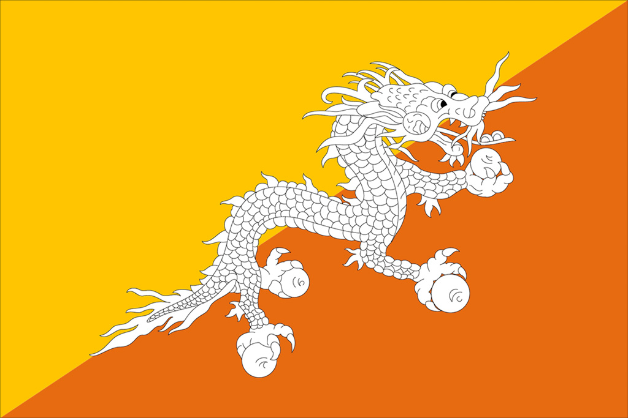
Challenges in Bhutan’s internet communications
Szymon Zylinski,
University of Warmia and Mazury in Olsztyn, Poland

Slide 2
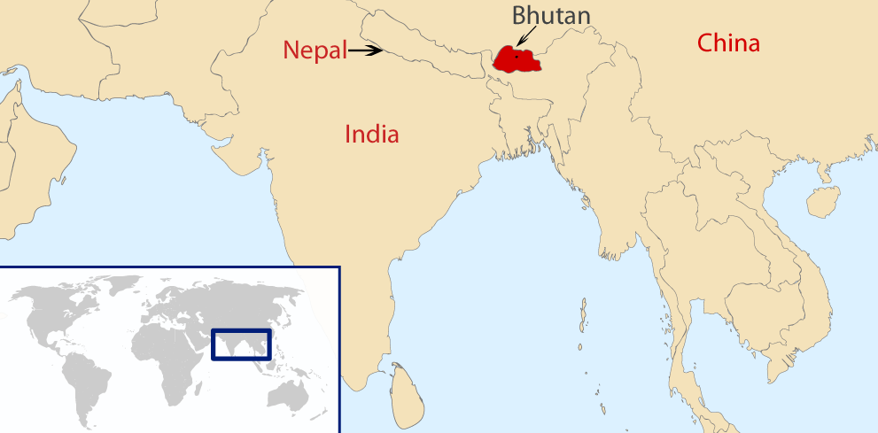

Slide 3
for centuries it was isolated from the outside world and cultivated its own set of traditions, beliefs
modern communication technologies: - radio and press 1980’s - TV 1999 - Internet 2000

Slide 4
Review paper
English is the language of: education politics most media

Slide 5
Computer were first brought to Bhutan in 1984 and were used in government institutions however their use was limited due to the unstable power supply

Slide 6
Bhutanese were/are very careful to adopt new technologies - not only caused by traditional upbringing and ages old Buddhist customs cultivation but also strongly influenced by Gross National Happiness (GNH) policy

Slide 7
King Jigme Dorji Wangchuck proposed that indicator, built on the negation of Gross National Product (GNP) index
GNH measures nations development not by economic qualifier but by sense of citizens’ happiness

Slide 8
Nowadays cellular communications is the most popular one
92,8% of households now own mobile phones
58,5% own a TV set and
38.8% own a radio set
16.4% own a computer

Slide 9
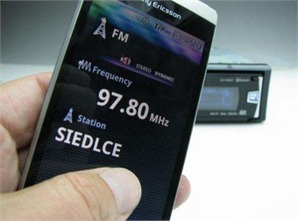
radio gave way to mobile phones that originally come with built-in FM radio functionality
2 in 3 persons own a mobile phone

Slide 10
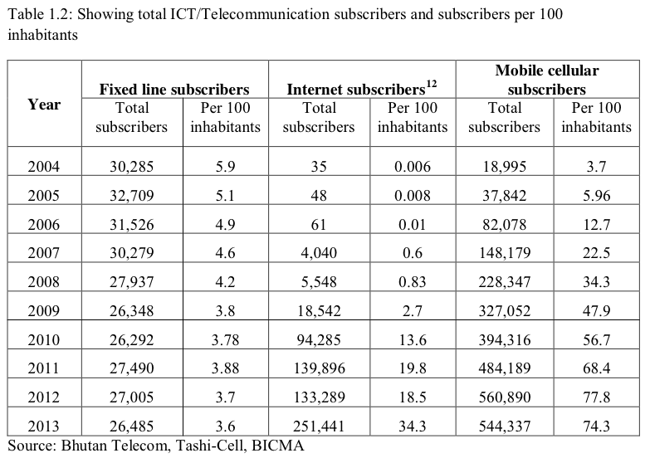
Annual InfoComm and Transport Statistical Bulletin (5th Edition, March 2014), Ministry of Information and Communications. Royal Governemt of Bhutan, Bhutan 2014, access: http://www.moic.gov.bt/daden/uploads/2014/04/statistic2013.pdf, 07.11.2014, p. 9.

Slide 11
Sonam Tobgay and Kencho Wangmo named a few challenges that Bhutan’s ICT sector faces:
lack of awareness and understanding
lack of ICT expertise and skills
lack of private sector participants
poor research and development initiatives
lack of budget for ICT sector
limited internet access
poor content in the national language
poor local content
difficulties in deploying Internet

Slide 12
However for the purpose of this prestantation 3 categories were developed:
- Axis of tradition and modernity
- Institutional involvement
- Terrain barriers

Slide 13
Axis of tradition and modernity
Sangay Ngedup, a former prime minister in one interview said:
“Until recently, we shied away from killing insects and yet now we Bhutanese are asked to watch people on TV blowing heads off with shotguns”.
E. Weiner, Goegraphy of Bliss, New York 2008, p. 109.

Slide 14
Axis of tradition and modernity
Technologies like information and communication (ICT) have become vital components in teaching and learning process and have alleviated innovation skills
distance and online learning is often considered suspicious by staff, employers, and students alike

Slide 15
Axis of tradition and modernity
Internet in Bhutan : - is welcomed by the youngest generation that embraced it with great enthusiasm and - is used for learning activities and improving language skills, instant communication with family members across the country as well as abroad

Slide 16
Axis of tradition and modernity
Mobile connectivity and use of cellular phones to access social media is a trend growing exponentially
Facebook is a useful tool in bringing attention to social problems and difficulties: Buddhist monk was sentenced to three-year in prison for possessing $3 worth of tobacco

Slide 17
Axis of tradition and modernity
Income level does not play a big role in Internet usage but level of education and job do
Civil servants, corporate and public employees spend more time browsing web, than business owners, students or people with other profession

Slide 18
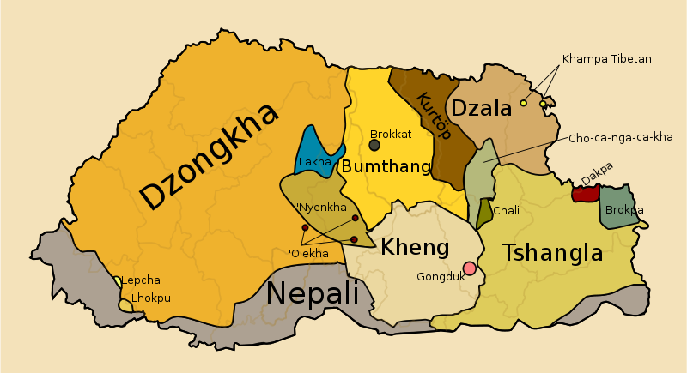
Axis of tradition and modernity
Eighteen different languages are spoken in Bhutan

Slide 19
Axis of tradition and modernity
The national language – Dzongkha – the only one with the native literary tradition is well known to most of the Bhutanese, however it written form is not familiar to the majority of Bhutanese people:
19,3% read Bhutanese websites in English
0.4% read in Dzongkha

Slide 20
Institutional involvement
At the beginning of new media introduction help from outside organizations needed
Pan Asia Networking, helped establish Bhutan’s first Internet provider DrukNet, international email access and helped built training facilities

Slide 21
Institutional involvement
Ministry of Education (MOE) in the year 2000 started supporting the higher secondary schools particularly with providing computers, LCD’s, internet, multimedia and e-learning resources

Slide 22
Institutional involvement
Education Information Technology program - started in 2003 - provides teachers and students with the basic ICT knowledge - equip 75% of schools with computers

Slide 23
Institutional involvement
the quality of web discourse may be improved
In 2007 The Bhutan Information, Communication and Media Authority (BICMA) requested internet providers to block, in their opinion offensive, website: bhutantimes.com, which presented information about Bhutan both from local and international perspective

Slide 24
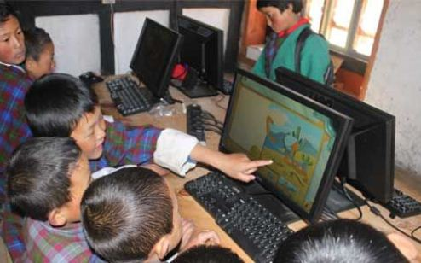
Institutional involvement
Main hubs of transferring information among locals are Community Centres
Out of 185 Community Centres 63 are connected with Interne

Slide 25
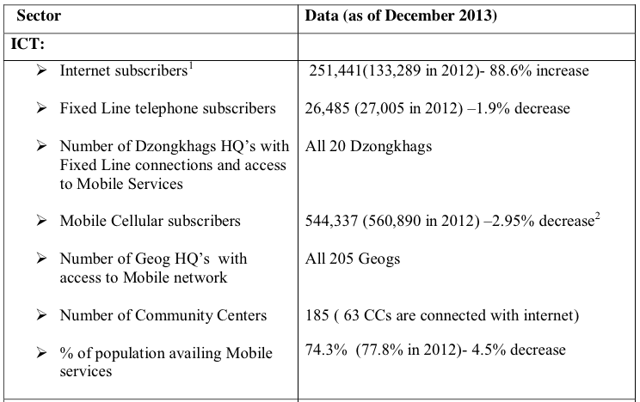
Annual InfoComm and Transport Statistical Bulletin (5th Edition, March 2014), Ministry of Information and Communications. Royal Governemt of Bhutan, Bhutan 2014, p. 5.

Slide 26
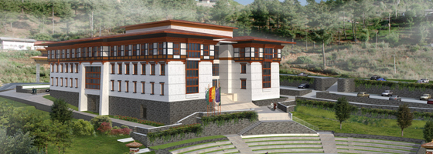
Institutional involvement
Most recent Bhutan’s investment into expanding digital topography is the creation of first IT park “Thimphu TechPark

Slide 27
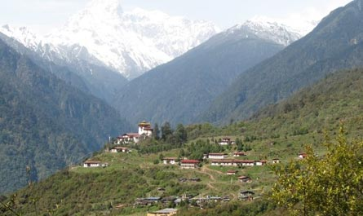
Terrain barriers
Bhutan is a mountainous country in the Himalayas with the elevation from 100m to 7000m
It is extremely difficult and expensive to lay infrastructure necessary to connect scattered human settlement

Slide 28
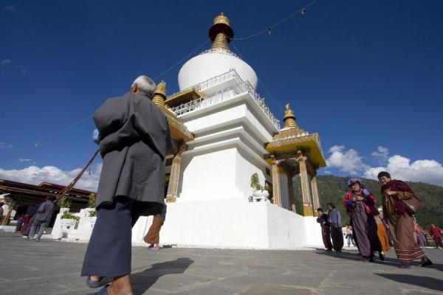
Terrain barriers
Main towns have Internet connection
People from rural areas do not have access to it and to get to the nearest internet point it may take up to 12 days of walking

Slide 29
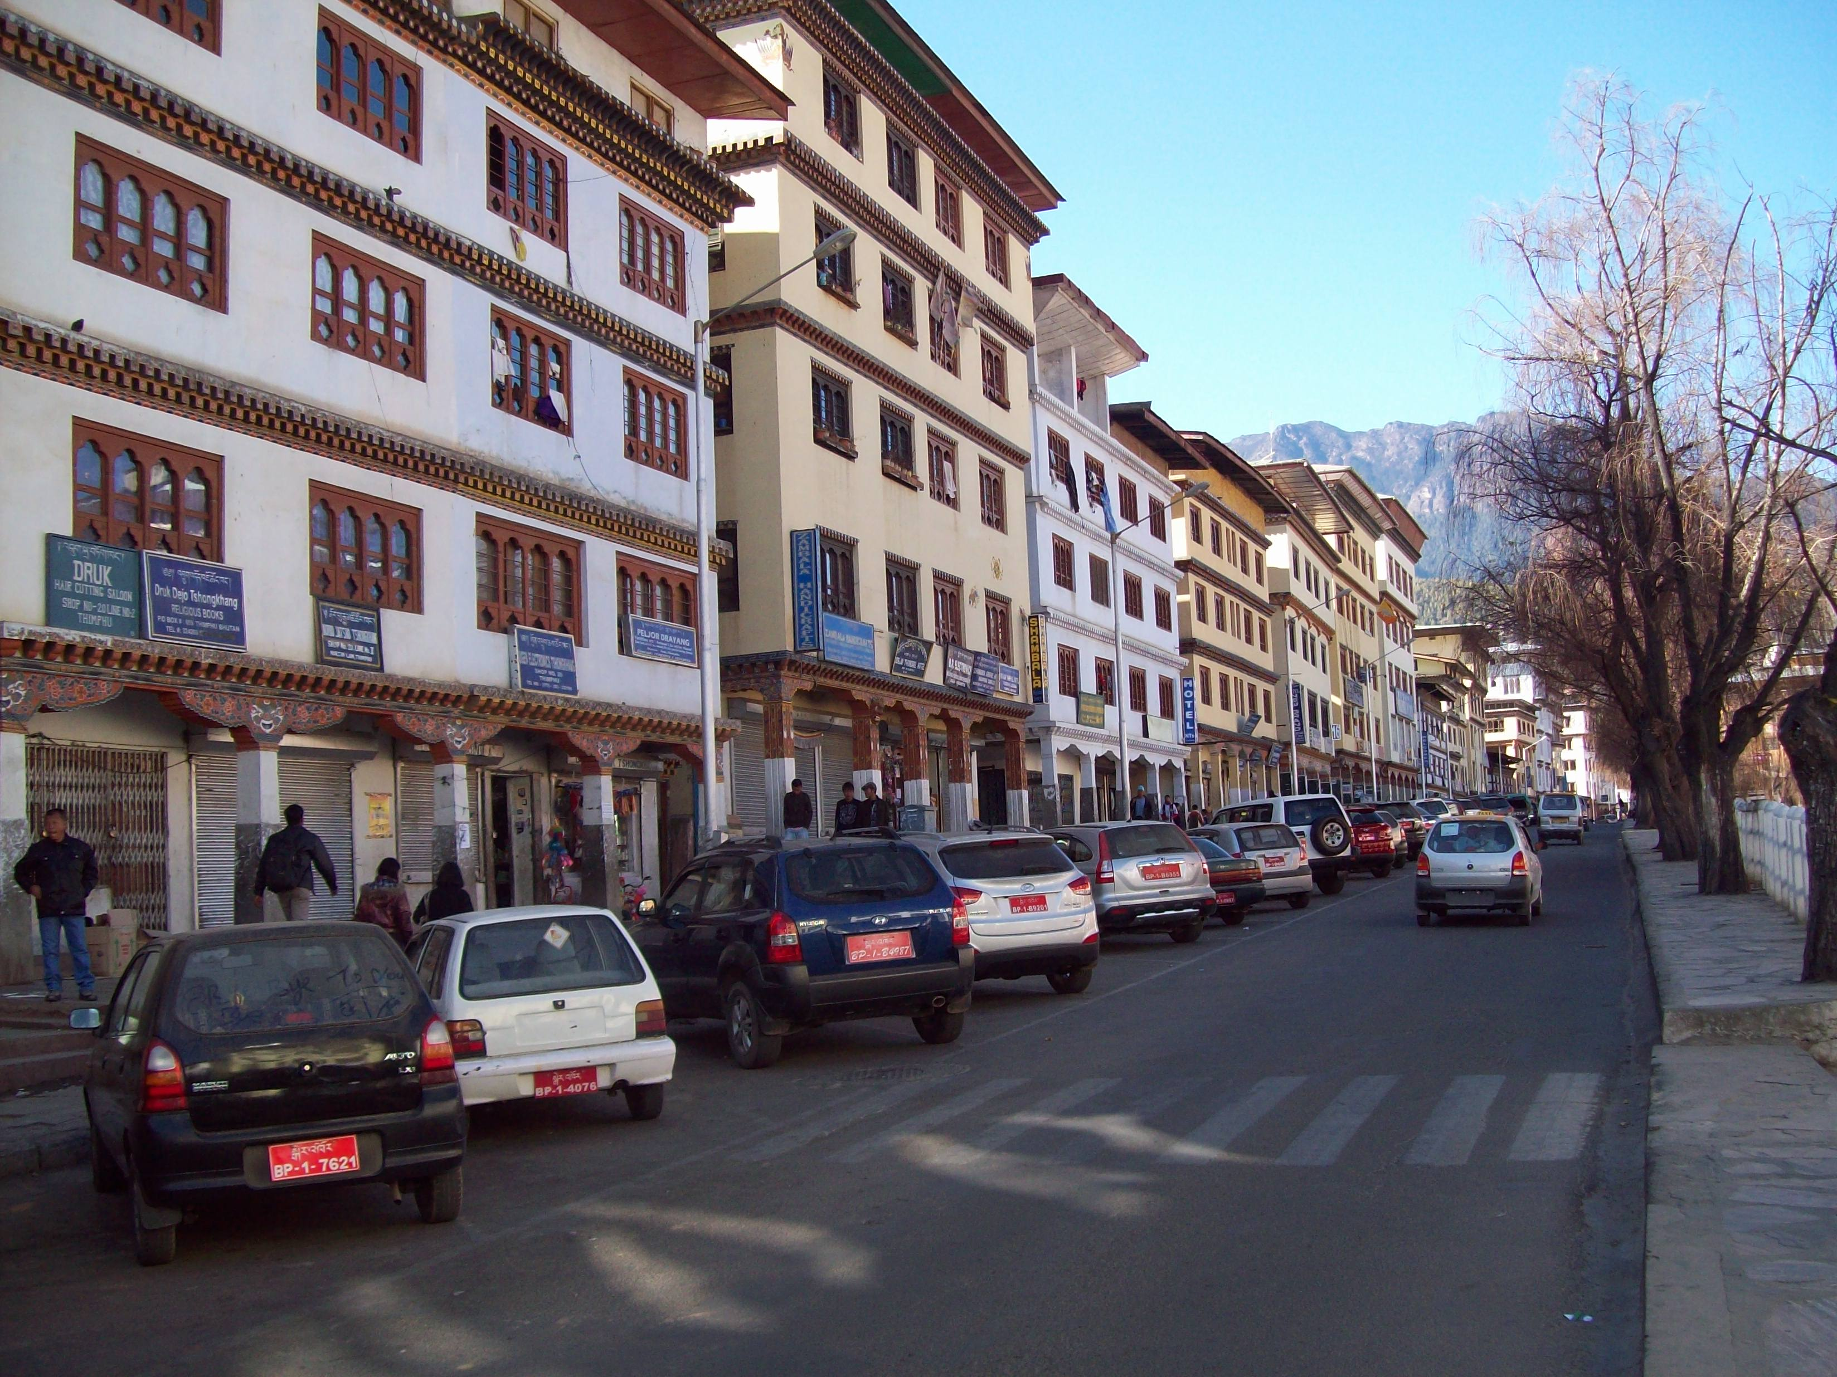
Terrain barriers
Natural barriers also block newest technological endeavours
Some communication technologies (such as 4G connections) are only deployed in the capitol – Thimpu

Slide 30
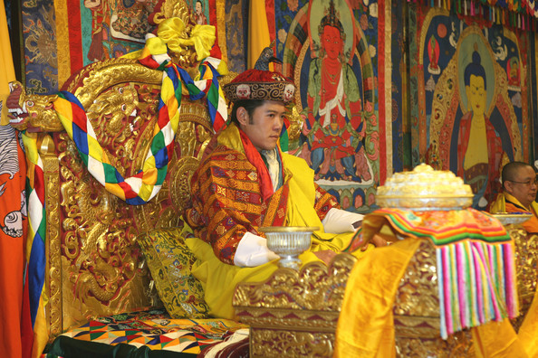
Terrain barriers
The Government of Bhutan fully understands the need of establishing competitive, level-playing and reliable ICT infrastructure market because it has the potential to overcome geographical challenges

Slide 31
Conclusion
Siok Sian Pek-Dorji, Media Consultant from Thimpu, an insider of Bhutam mentality, tradition and media
“We should avoid the <<dumbing down>> of media that is happening elsewhere in the world, where media feed misinformation and provide sensationalism producing a Disney-type happiness and entertainment; this will lead us far from the path to GNH”

