Slide 1
Michael Moesgaard Andersen mma@aag.dk
Private and public efforts in the development of telecommunications in Africa based on selected case stories
18 November 2014

Slide 2
Experience from:
Regulating
Consulting
Investing
Researching
− The triangulation of experience...
REGULATING
RESEARCHING
CONSULTING
INVESTING

Slide 3
Huawei
Countryside surrounding cities
Hunting in packs like wolves
Helping hands from the Chinese Government
Oil for mobile communications
Export credits and State lending efforts
A different business model
Africa as a ”pitstop” towards the industrially developed countries

Slide 4
Huawei
“…nearly every African country has partnered with the Chinese company in some form. Usually, that means either smartphone distribution or network infrastructure deployment”

Slide 5
Huawei as a Black Swan company

Slide 6
Huawei as a Black Swan company

Slide 7
Huawei as a Black Swan company

Slide 8
Huawei as a Black Swan company

Slide 9
Huawei as a Black Swan company

Slide 10
Huawei as a Black Swan company

Slide 11
Huawei as a Black Swan company

Slide 12
Huawei as a Black Swan company

Slide 13
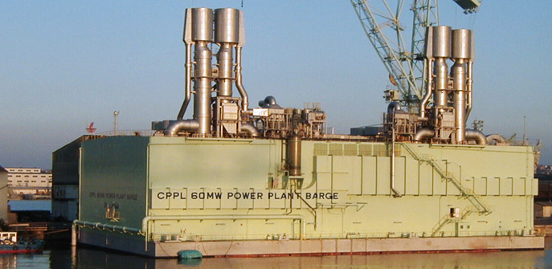
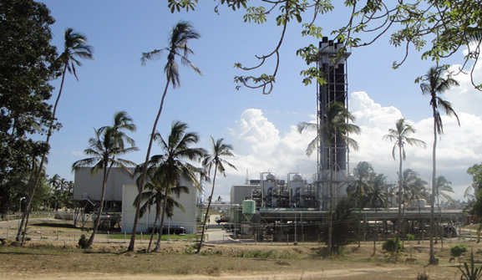
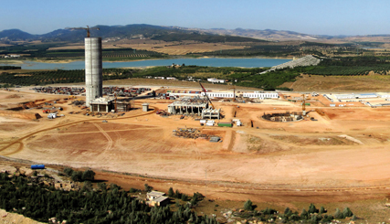
DANIDA
Never particularly fond of telecommunications
More keen on roads, bridges, power plants, cement factories =
White Elephants

Slide 14
On mobile communications
In connection with a national telecommunications strategy for Ghana:
”DANIDA will never support anything related to mobile communications. This is only for the rich people and mobile communications will be inconsistent with DANIDA’s policy to support the poor people”

Slide 15
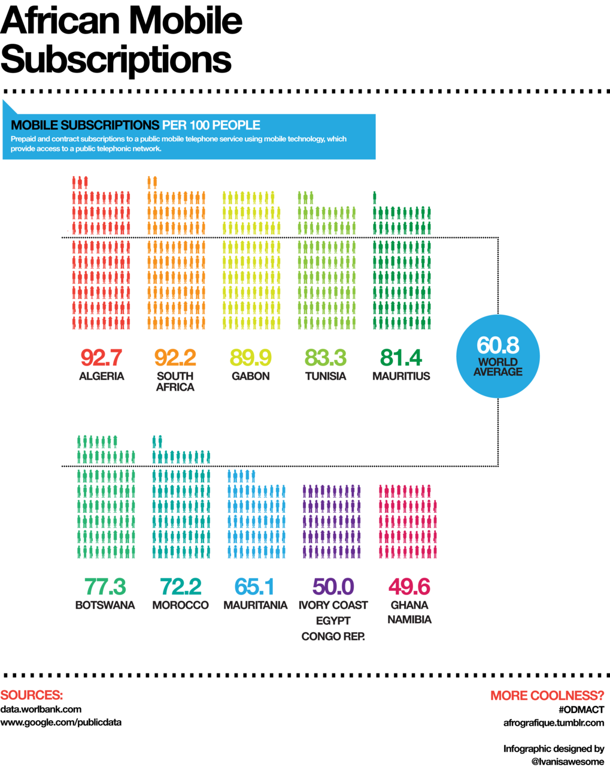
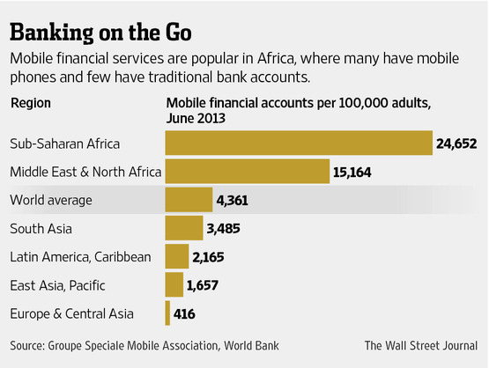
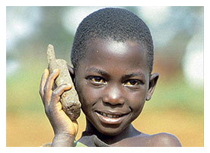
The reality of today

Slide 16
The case of Malawi
Tender for a turn key project
Subsequent change to include local participation
Danida decisions: a) the stocks managed by local natives and b) ducts to be established by local natives
Outcome?

Slide 17
Conclusions
Chinese mobile achieving world leadership based on Africa
Industrial policy and aid go hand in hand
Turn key as project technology
DANIDA – White Elephants
No firm relationship btw mobile industry and aid
Local participation a requirement in fixed network projects
Milder winds today???

Slide 18
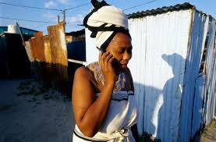
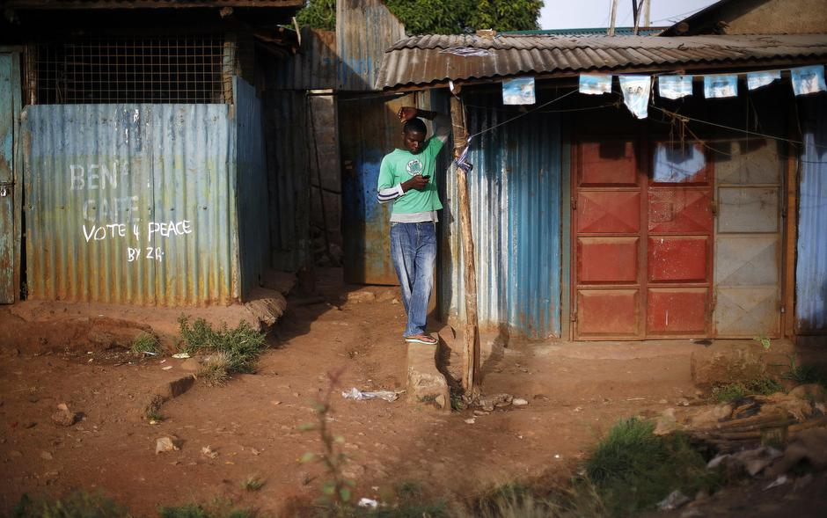
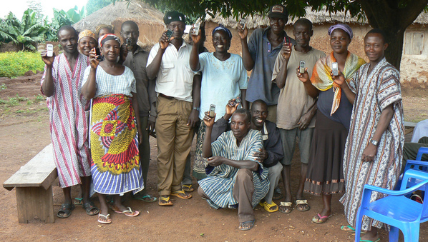
Poor Africans – most advanced usage!

